Slide 1
Lab 5: Design sequential circuit

Slide 2
D flipflop
D flipflop truth table
clk | d | q
 | 1 | 1
 | 0 | 0
other values | x | previous value
- Design D flip flop using always_ff and non-blocking assignment.
- Using always_ff statement to model the behavior of sequential logic elements such as flip-flops,
registers,…..
- It ensures that the enclosed code block is executed only when there is a change on the clock signal.
Ex: always_ff @(posedge clock) begin
// Your sequential logic here
end
- Using non-blocking assignment.

Slide 3
D- flipflop
d_flipflop.sv | d_flipflop_tb.sv
module d_flipflop(input logic clk, d, output logic q); always_ff@(posedge clk) begin q <= d; end endmodule | module d_flipflop_tb(); logic clk, d, q; d_flipflop dut(clk, d, q); //Clock signal generation always begin clk = ~ clk; #5; end always begin d = ~ d; #3; end initial begin clk = 0; d = 0; end endmodule

Slide 4
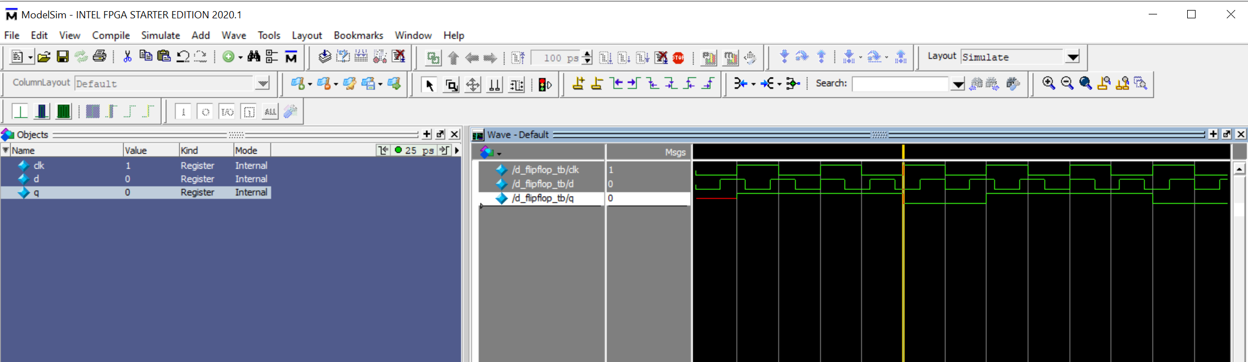
D- flipflop simulation result

Slide 5
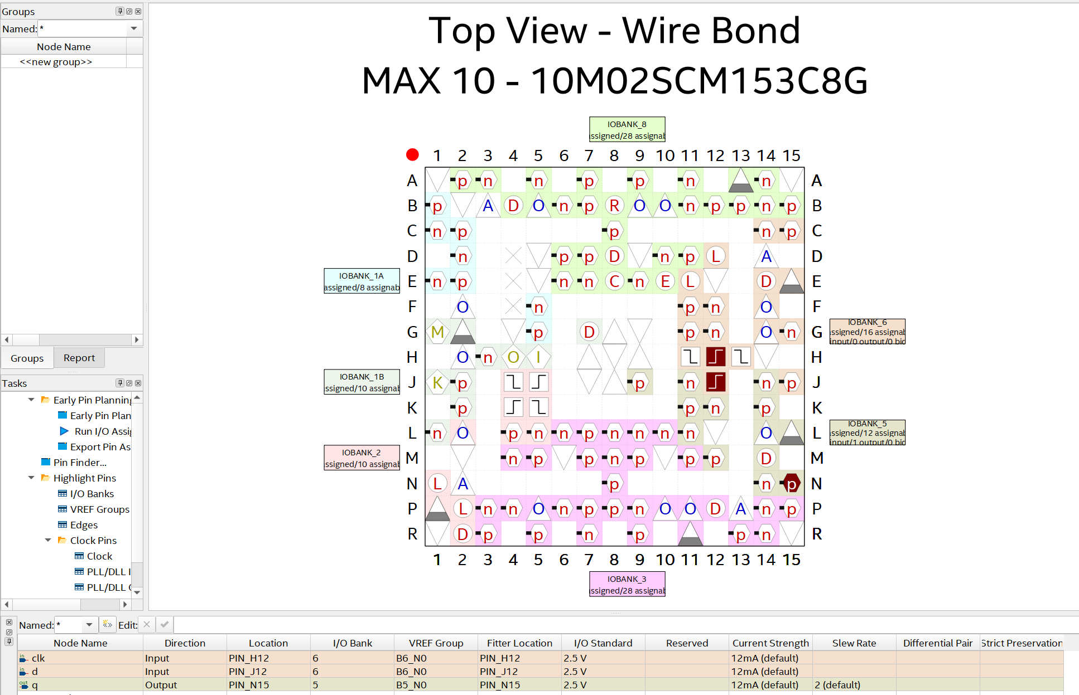
Test D-flipflop on STEP-MAX10 board -
Method 1: Assign clock signal to a switch on STEP – MAX10 board. Using switch to create clock signal.

Slide 6
Test D-flipflop on STEP-MAX10 board
Method 2: Using 12MHz clock on STEP-MAX10 board
d_flipflop.sv | clock_devider.sv | top_module.sv
module d_flipflop(input logic clk, d, output logic q); always_ff@(posedge clk) begin q <= d; end endmodule | module clock_divider ( input logic clk_in, // 12 MHz input clock output logic clk_out // 1 Hz output clock ); logic [23:0] counter = 24'd0; // 24-bit counter always_ff @(posedge clk_in) begin if (counter == 24'd6000000) begin counter <= 24'd0; clk_out <= ~clk_out; // Toggle output clock end else counter <= counter + 1; end endmodule | module top_module ( input logic clk_12mhz, // 12 MHz input clock input logic d ;// D input for D flip-flop output logic q // Q output of D flip-flop ); // 1 Hz clock signal logic clk_1hz; // Instantiate clock divider clock_divider clock_divider_instance (clk_12mhz, clk_1hz); // Instantiate D flip-flop d_flipflop d_flipflop_instance (clk_1hz, d, q); endmodule

Slide 7
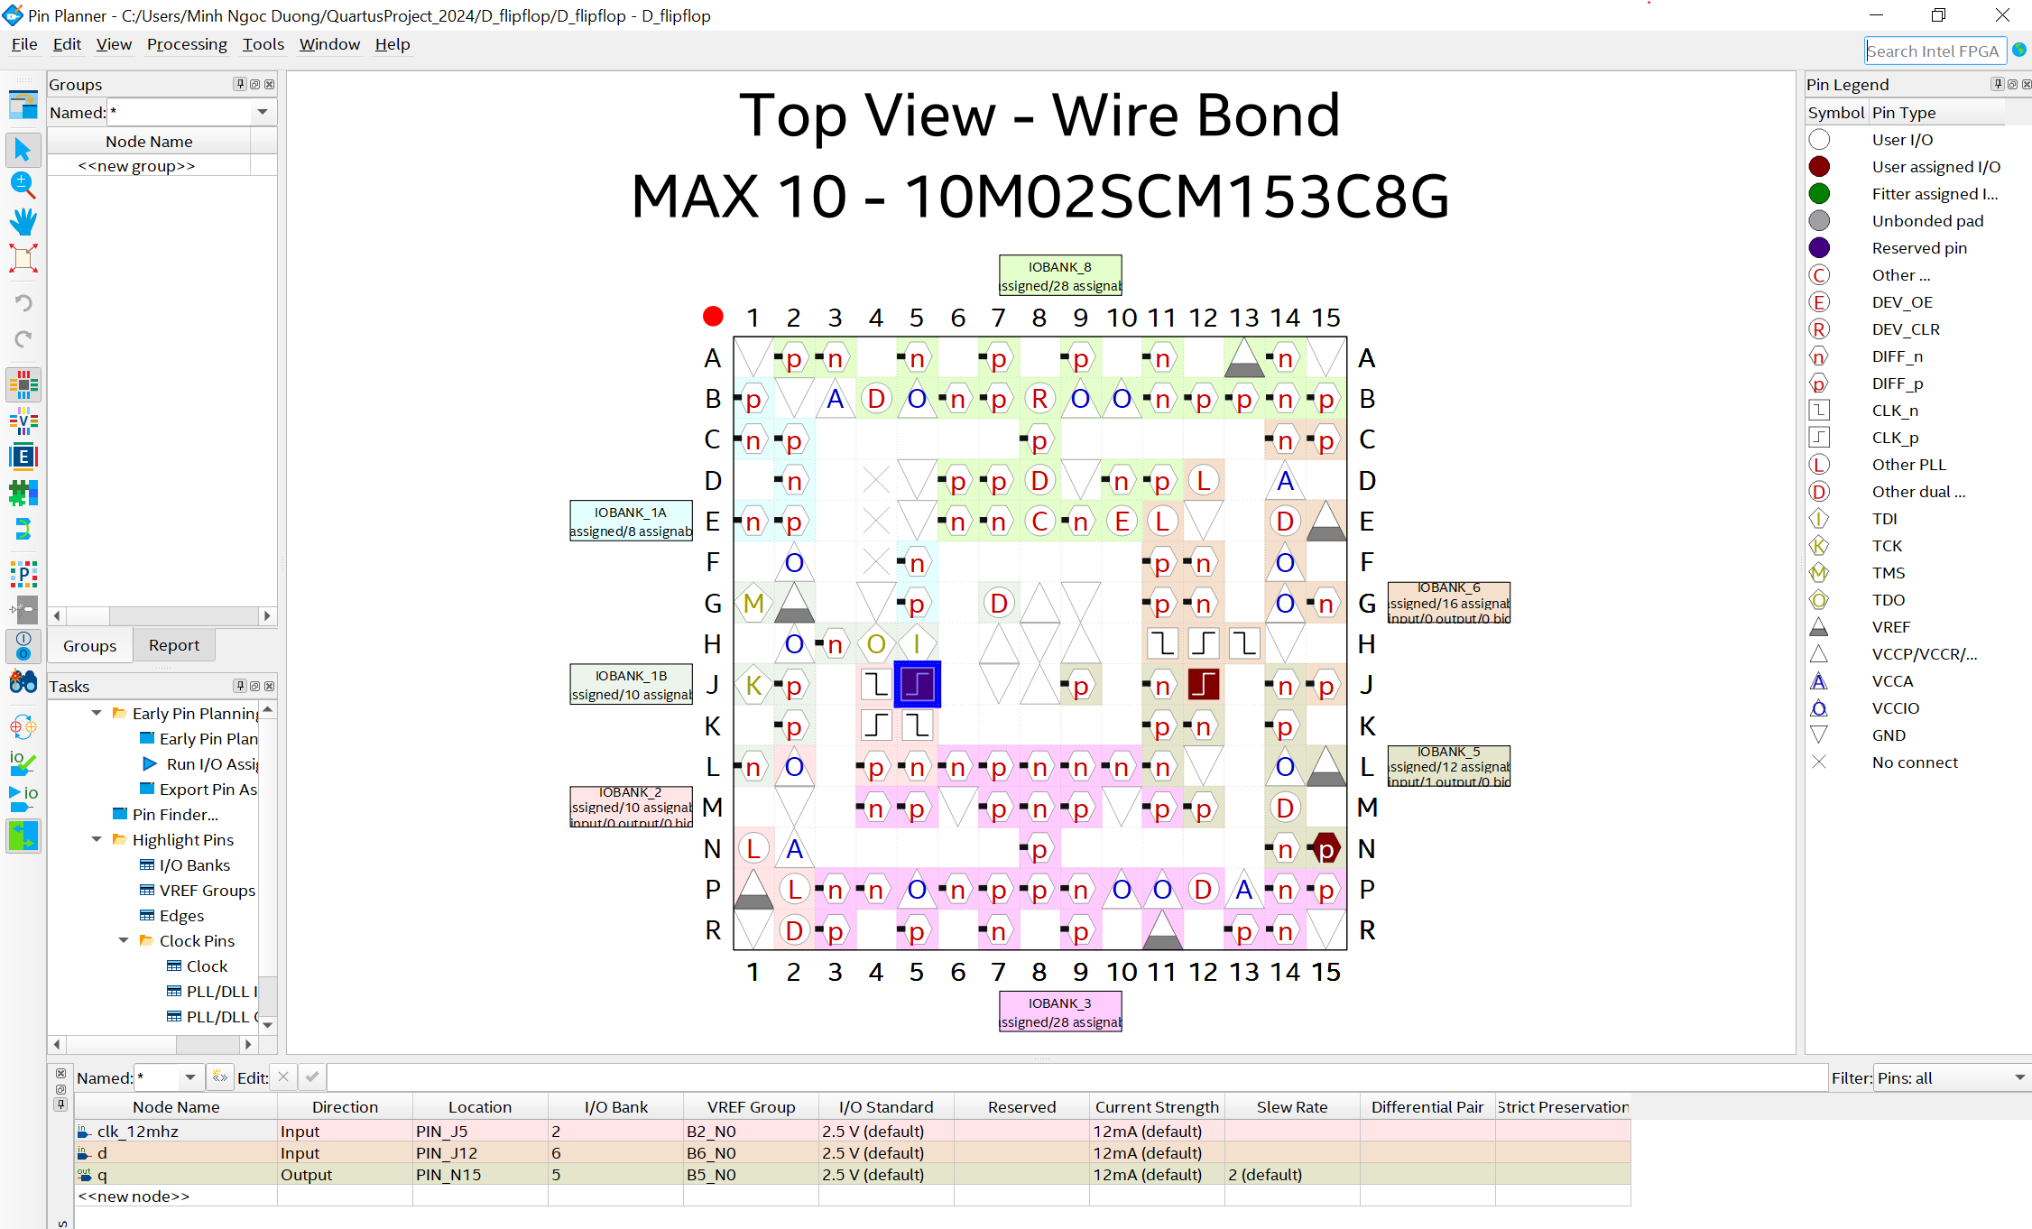
Pin assignment

Slide 8
Common used statement
for | case
for (initialization; condition; increment) begin // Loop body end | case (expression) value1: begin // Code for when expression matches value1 end value2: begin // Code for when expression matches value2 end // More value cases... default: begin // Code for when no value case matches the expression end endcase
if – else | while
if (condition) begin // Statements to execute when the condition is true end else begin // Statements to execute when the condition is false end | while (condition) begin // Statements to execute while the condition is true end

Slide 9
Resettable flipflop
Ex1: Design an resettable flipflop having following truth table using in SystemVerilog and simulate on ModelSim and test on STEP MAX10 board.
clk | reset | d | q
 | 1 | x | 0
 | 0 | 1 | 1
 | 0 | 0 | 0
other values | x | x | previous value

Slide 10
Resettable enable flipflop
Ex2: Design an resettable enable flipflop having following truth table using in SystemVerilog, simulate on ModelSim and test on STEP MAX10 board.
clk | reset | enable | d | q
 | 1 | x | x | 0
 | 0 | 1 | 1 | 1
 | 0 | 1 | 0 | 0
 | 0 | 0 | x | previous value
other values | x | x | x | previous value

Slide 11
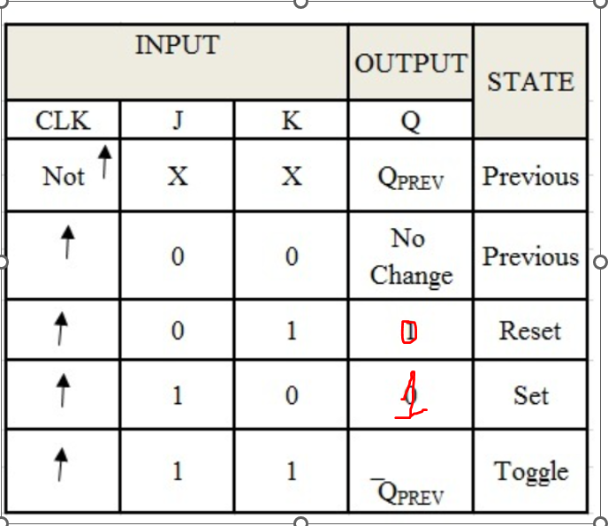
JK flipflop
Ex3: Design an JK flipflop having following truth table using in SystemVerilog, simulate on ModelSim and test on STEP MAX10 board.

Slide 12
D latch
Ex4: Design an JK flipflop having following truth table using in SystemVerilog, simulate on ModelSim and test on STEP MAX10 board.
clk | d | q
1 | 1 | 1
1 | 0 | 0
0 | x | previous value
Using always_latch statement, which is used for design a latch in SystemVerilog
always_latch is equivalent to always@(clk, d).
always_latch begin //your code here end | always@(clk, d) begin //your code here end

